Slide 1
Frankenstein’s Python
Python & Science

Slide 2
Structure
Week 1: Introduction
Week 2: Syntax, Variables & Functions
Week 3: Control Structures
Week 4: Lists & Collections
Week 5: RegEx & Strings
Week 6: Sorting & I/O
Week 7:Debugging, Errors & Strategies
Week 8: 4P: Packages, Practices and Patterns
Week 9: Object Oriented Programming
Week 10: Time, Space & Documentation
Week 11: Numpy & Matplotlib
Week 12: Python & Science
Week 13: Neural Nets
Week 14: Honorable Mentions & Wrap Up

Slide 3
Python & Neuroscience
Many experiments you will conduct in neuroscience these days are run with the help of a script
The script will most often be responsible for both leading the subject through the experiment and collecting data
Working with Python to create our experiment scripts is a good idea as there are many libraries that can help you build an experiment and handle your data
In this lecture, we are going to introduce you to some of them

Slide 4
Experiment Frameworks: PsychoPy & Expyriment

Slide 5
Let’s Build an Experiment
Let’s compile a list of things we (usually) need to build our own psychology experiments:
Some sort of graphic surface
Like a window
Stimuli
Like fixation points, shapes, user instructions
We also need to know how to display them on the graphic surface
User input
Like key presses
The actual experiment procedure
Data logging
Plus, potentially communicating with other devices like eye trackers, EEG, ...
That’s a lot of things to consider….

Slide 6
PsychoPy and Expyriment
Both PsychoPy and Expyriment are libraries that offer tools for the creation of psychological experiments
So they give us the possibility to implement the little building blocks we need for our experiments
In the following, we will mostly consider the main things mentioned on the previously slide
But there are more functionalities one might need in an experiment that are supported as well

Slide 7
PsychoPy

Slide 8
PsychoPy
PsychoPy is an open-source library specifically designed for psychology and neuroscience experiments
http://www.psychopy.org/about/overview.html
It is the most commonly used experimental psychology library as of now
(probably)

Slide 9
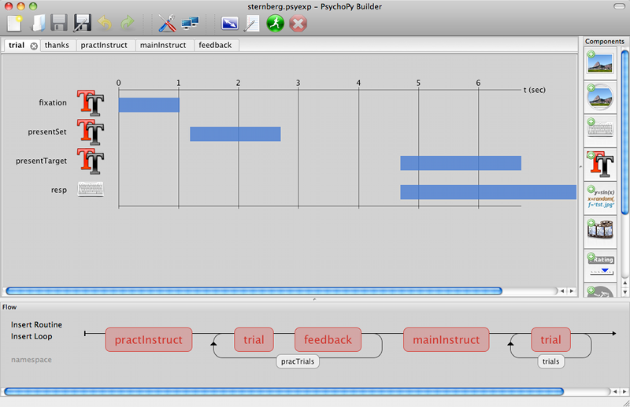
PsychoPy - Builder and Coder
PsychoPy has two interfaces: the Builder and the Coder
The Builder offers a GUI in which users can plug together their experiments
The Coder offers packages we can incorporate into our Python scripts to code the experiments
Here, we’re going to focus on the Coder:
It offers more control over the experiments
We’re all pro-coders now that love writing our own code ;)
Builder image taken from official website

Slide 10
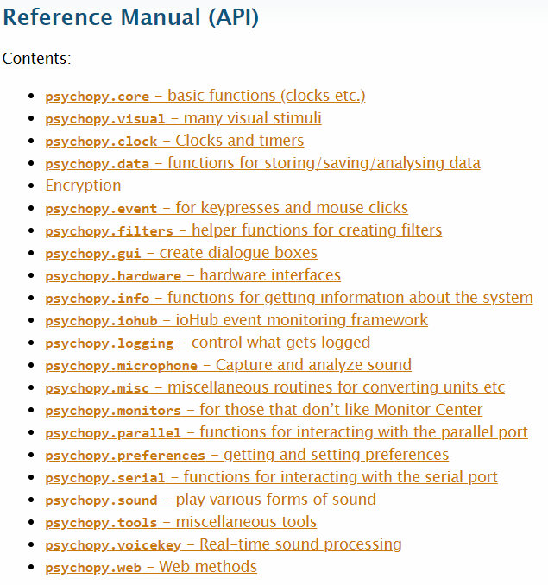
PsychoPy - The Coder
This is an overview of the packages included in the PsychoPy coder as listed in the documentation
The ones we need today are core, visual, data and event
You can find the manual here
We will now walk through our list of experiment building blocks step by step

Slide 11
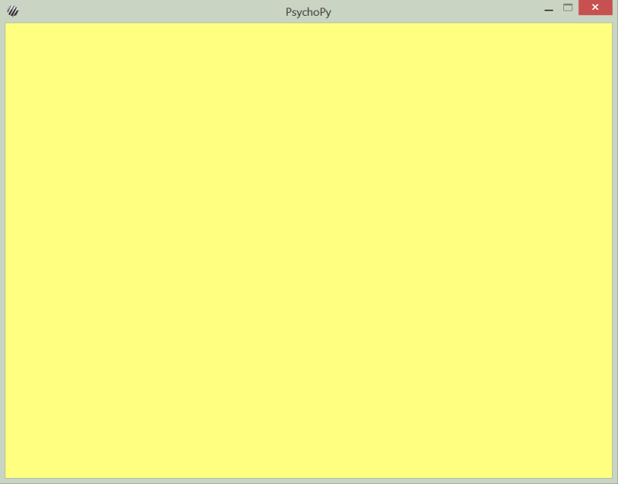
1. PsychoPy – Graphic Surface
In PsychoPy, our graphic surface will be an object of class Window
that shouldn’t be too hard to remember
Window objects are part of the package visual
So let’s import that first
Now we can create a window:
Looks pretty boring, eh?
from psychopy import visual
# create window of size 800x600px on a monitor object we'll call testMonitor and with yellow color
# the scaling unit for object sizes and locations is normalized between -1 and 1
mywin = visual.Window([800,600], monitor="testMonitor", units="norm", color=[255,255,0])

Slide 12
2. PsychoPy - Stimuli
visual also contains classes for several visual stimuli
Like text stimuli, shapes (e.g. circles and rects), patterns (like grating stimuli), …
We’ll start out by adding a fixation point in the middle of the screen
from psychopy import visual
mywin = visual.Window(size=[800,600], monitor="testMonitor", units="norm", color=[255,255,0])
# create grating simulus on our window, size 0.015, center position, spatial frequency 0
# (grating stimulus is otherwise striped), pitch black (-1) color
fixation = visual.GratingStim(win=mywin, size=0.015, pos=[0,0], sf=0, color=-1)

Slide 13
2. PsychoPy - Stimuli
However, for our stimulus to show, we need to do two more things:
First is fixation.draw()
for the stimulus to actually be drawn
Then we need to do mywin.flip()
For our drawing to show
The reason for this is that the fixation is drawn on the back buffer where all objects are drawn before they are shown
Meanwhile, the front buffer is in place and holds everything we currently see
Flipping will swap the front and back buffers such that after drawing is finished, the drawing can be shown on the new front buffer while the next drawing can be prepared on the new back buffer

Slide 14

2. PsychoPy - Stimuli
So our code now looks like this:
from psychopy import visual
mywin = visual.Window(size=[800,600], monitor="testMonitor", units="norm", color=[255,255,0])
fixation = visual.GratingStim(win=mywin, size=0.015, pos=[0,0], sf=0, color=-1)
fixation.draw()
mywin.flip()

Slide 15
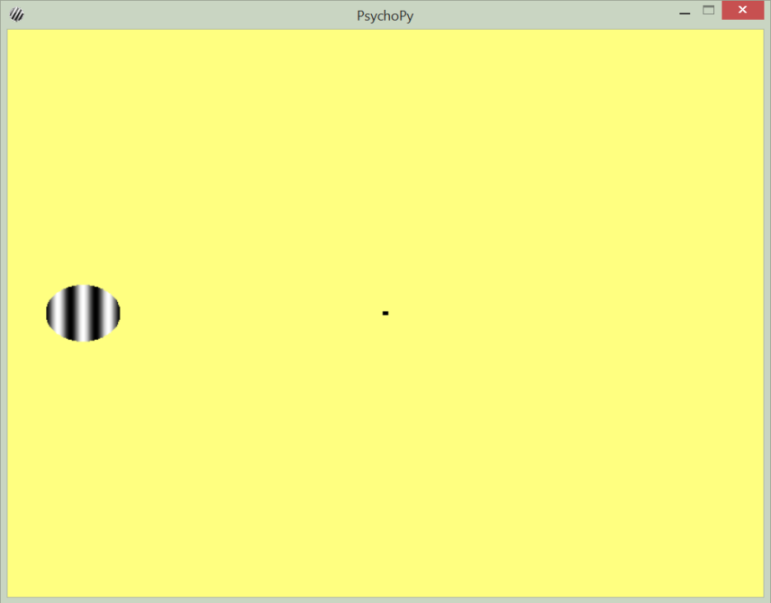
2. PsychoPy - Stimuli
Next, we’ll add another (actual) grating stimulus to the family
Beautiful.
from psychopy import visual
mywin = visual.Window(size=[800,600], monitor="testMonitor", units="norm", color=[255,255,0])
fixation = visual.GratingStim(win=mywin, size=0.015, pos=[0,0], sf=0, color=-1)
grating = visual.GratingStim(win=mywin, mask="circle", size=0.2, pos=[-0.8,0], sf=3)
fixation.draw()
grating.draw()
mywin.flip()

Slide 16
3. PsychoPy - User Input: waitKeys()
With our current code, we don’t have much time to look at the window though – it closes right away
To prevent this from happening, we can wait for a key press from the user with event.waitKeys()
This function has some extra parameters as well, for example, we can specify which keys to look for – this is arguably the most common usage though
import event to be able to do this
from psychopy import visual, event
mywin = visual.Window(size=[800,600], monitor="testMonitor", units="norm", color=[255,255,0])
fixation = visual.GratingStim(win=mywin, size=0.015, pos=[0,0], sf=0, color=-1)
grating = visual.GratingStim(win=mywin, mask="circle", size=0.2, pos=[-0.8,0], sf=3)
fixation.draw()
grating.draw()
mywin.flip()
event.waitKeys()
and add waitKeys() here

Slide 17
3. PsychoPy - User Input: Global Keys
However, it would be pretty inconvenient if keys presses could only be processed whenever the program is currently waiting for some key to be pressed
To avoid this, we can define global keys that execute a function whenever they are pressed
Lets make a key event for the escape button: Quit the program when it is pressed
The core.quit() function can be used for this, so we’ll also need to import the module core
For this to work, you have to deactivate Num Lock!
Don’t ask us why. We don’t know. Seriously.
# add 'escape' to global keys. core.quit() function is executed when escape button is pressed
event.globalKeys.add(key='escape', func=core.quit)

Slide 18
3. PsychoPy - User Input: Putting it Together
from psychopy import visual, event, core
mywin = visual.Window(size=[800,600], monitor="testMonitor", units="norm", color=[255,255,0])
fixation = visual.GratingStim(win=mywin, size=0.015, pos=[0,0], sf=0, color=-1)
grating = visual.GratingStim(win=mywin, mask="circle", size=0.2, pos=[-0.8,0], sf=3)
event.globalKeys.add(key='escape', func=core.quit)
fixation.draw()
grating.draw()
mywin.flip()
event.waitKeys()
mywin.flip()
event.waitKeys()
So now we have a nice little program with a fixation and a stimulus that closes itself on the escape key and for any other key press wipes the screen
And then closes itself after pressing another key
Now we want to include some sort of experiment condition

Slide 19
4. PsychoPy – Experiment Procedures
Usually, experiments consist of various trials with different conditions
For this, we can use the TrialHandler and the StairHandler
Both can handle the selection of the next trial and data storage
The TrialHandler can choose a trial (sequentially or randomly) out of a list of pre-defined conditions
The StairHandler uses an adaptive staircase, which means that each trial, the next condition is generated based on the participant’s response
In the following, we will implement a simple TrialHandler

Slide 20
4. PsychoPy – Experiment Procedures
The TrialHandler is part of the module data
So remember to first import this module as well
Now, what we want to do is draw the grating stimuli sequentially at different horizontal positions
Since we are using the norm unit for our window, horizontal positions within the screen are between -1 and 1
So let’s choose 5 horizontal positions:
These are now our trials during the experiment
psychopy.data.TrialHandler(trialList, nReps, method='random', dataTypes=None, extraInfo=None, seed=None, originPath=None, name='', autoLog=True)
positions = [-1, -0.5, 0, 0.5, 1]

Slide 21
4. PsychoPy – Experiment Procedures
Now we can make a TrialHandler and feed the trials into it:
What’s left to do is to make a loop that executes all the conditions
positions = [-1, -0.5, 0, 0.5, 1]
# 1 repetition of all trials, in sequential order
handler = data.TrialHandler(positions, 1, method='sequential')
# go through all trials as given by the TrialHandler
for trial in handler:
# set grating stimulus to new position
grating.setPos([trial,0])
# draw all stimuli and wait for input
fixation.draw()
grating.draw()
mywin.flip()
event.waitKeys()

Slide 22
4. PsychoPy – Complete Code
from psychopy import visual, event, core, data
mywin = visual.Window(size=[800,600], monitor="testMonitor", units="norm", color=[255,255,0])
positions = [-1, -0.5, 0, 0.5, 1]
handler = data.TrialHandler(positions, 1, method='sequential')
fixation = visual.GratingStim(win=mywin, size=0.015, pos=[0,0], sf=0, color=-1)
grating = visual.GratingStim(win=mywin, mask="circle", size=0.2, pos=[0,0], sf=3)
event.globalKeys.add(key='escape', func=core.quit)
for trial in handler:
grating.setPos([trial,0])
fixation.draw()
grating.draw()
mywin.flip()
event.waitKeys()

Slide 23
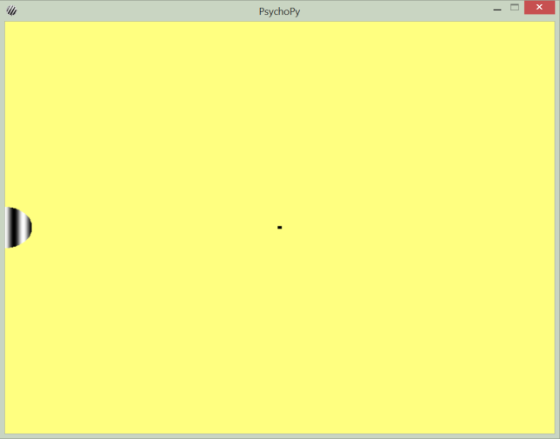
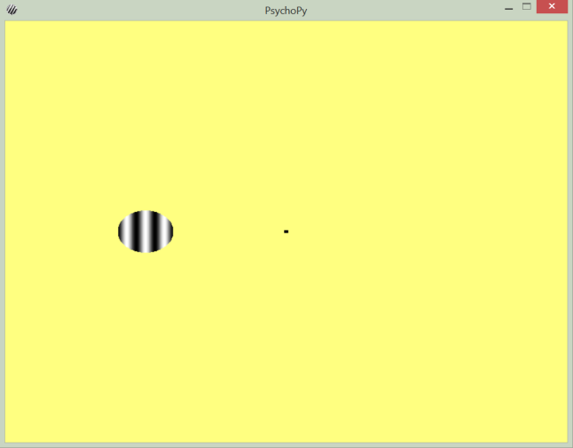
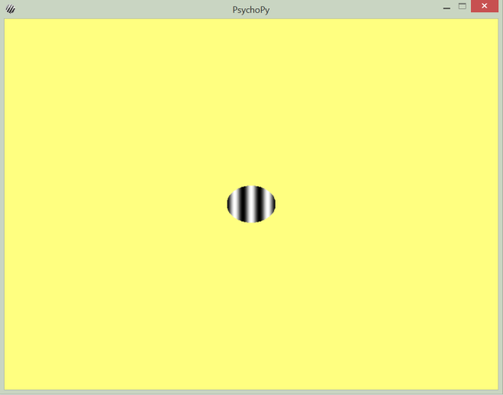
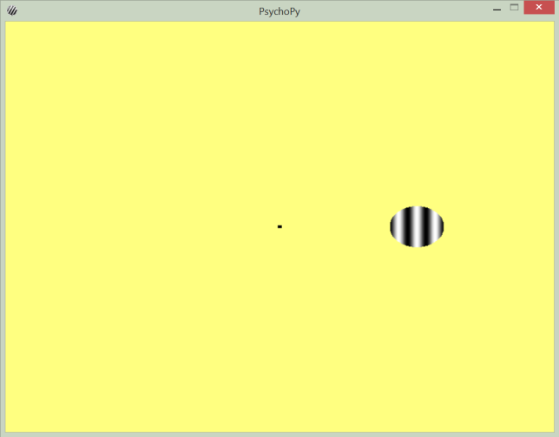
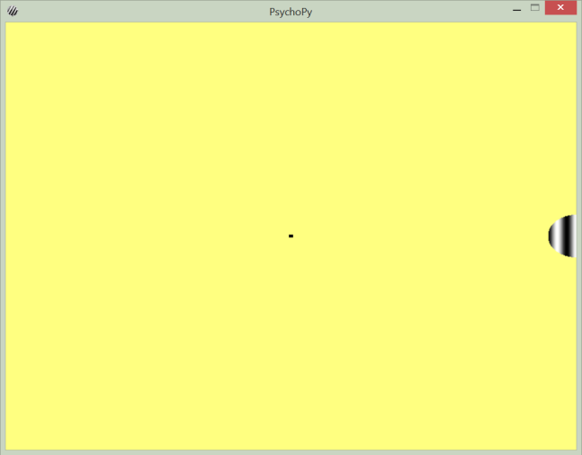
4. PsychoPy - The Program

Slide 24
5. PsychoPy - Data Logging
There are multiple ways to do data logging which would be out of scope for today’s lecture
Basically, you can just do this the way we’re used to (Python built-in file handling)
Or you can take a look at the documentation for details
Especially here and here

Slide 25
PsychoPy – Code Structure
Following these certain guidelines when structuring your code is recommended:
This is not the order in which you necessarily have to write your code – just how it is best structured in the end
from psychopy import visual, event, core, data
mywin = visual.Window(size=[800,600], monitor="testMonitor", units="norm", color=[255,255,0])
positions = [-1, -0.5, 0, 0.5, 1]
handler = data.TrialHandler(positions, 1, method='sequential')
fixation = visual.GratingStim(win=mywin, size=0.015, pos=[0,0], sf=0, color=-1)
grating = visual.GratingStim(win=mywin, mask="circle", size=0.2, pos=[0,0], sf=3)
event.globalKeys.add(key='escape', func=core.quit)
for trial in handler:
grating.setPos([trial,0])
fixation.draw()
grating.draw()
mywin.flip()
event.waitKeys()
first create the window
then the handler
then prepare all your stimuli before
you use them
then your global key events
then your actual procedure

Slide 26
PsychoPy – The Catch
We have a confession to make …
we have a strong aversion to PsychoPy …
…and this was us during multiple occasions of setting it up and creating some scripts:
It is barely runnable on Linux
Not entirely compatible with Python 3
The documentation is confusing and incomplete
(ノಠ益ಠ)ノ彡┻━┻
[insert Angry Panda Trashing PCs GIF]

Slide 27
Expyriment

Slide 28
Expyriment
Expyriment is an alternative to PsychoPy
http://docs.expyriment.org/index.html
It is better compatible with Python 3 and pretty easy to install and follow
At least that’s our impression
In the end it’s up to you what you want to use
┬─┬ ノ( ^_^ノ)

Slide 29
Expyriment - General Structuring
Experiments in Expyriment are structured like this:
There is an experiment
The experiment consists of blocks
The blocks consists of trials
So it’s good practice to follow this structure

Slide 30
0. Expyriment – Building the Frame
Before we can get into any of our experiment creation steps, we need to build the frame of our experiment
from expyriment import design, control
# create experiment object
exp = design.Experiment(name=“Cool Experiment")
# initialize experiment object and make it active experiment
# this will show a startup screen
# it will also initialize exp.screen, exp.mouse, exp.keyboard, exp.event and exp.clock
control.initialize(exp)
# this will present a subject number screen and a ready screen after initialization
# is completely finished
control.start()
# this will show an "ending experiment" screen and save data
control.end()

Slide 31
1. Expyriment– Graphic Surface
Through our experiment initialization, the window is already there
By default, however, it is a full screen window with a black background
Let’s change that!
from expyriment import design, control
control.defaults.window_mode = True # True corresponds to windowed
control.defaults.window_size = [800,600] # 800x600 resolution
# we are going to change the default background color for this experiment
# however this can also be changed later after initialization using exp.screen.colour() design.defaults.experiment_background_colour = (230,230,70)
exp = design.Experiment(name="Cool Experiment")
control.initialize(exp)
control.start()
control.end()

Slide 32
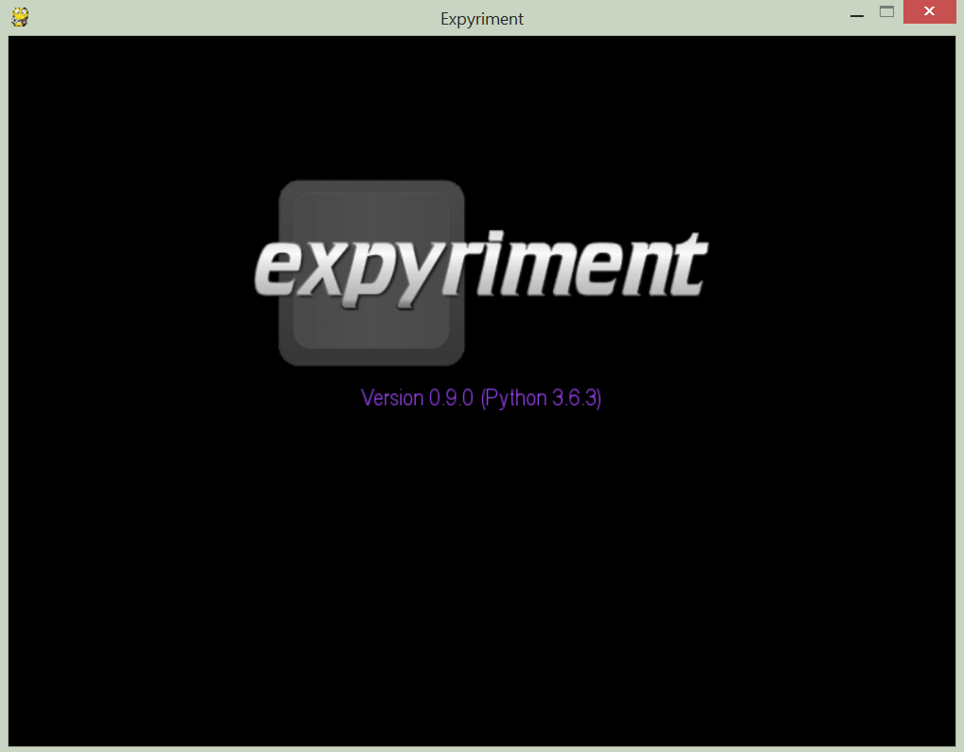
1. Expyriment– Graphic Surface
Now everything is in a neat little window, but we won’t see much of our newly set background color as the experiment itself is still empty
The startup screen is unaffected by our color change
So we need to define and show some stimuli!

Slide 33
2. Expyriment - Stimuli
We will, again, start with a point for fixation
But first, we update our import statement
To keep a clear structure, we want to attach this stimulus to a trial in a block
Therefore, we also need a block and a trial
from expyriment import design, control, stimuli
# put this after initializing the experiment
block_one = design.Block(name="Our only block")
tmp_trial = design.Trial()

Slide 34
2. Expyriment - Stimuli
Now we can create our stimulus!
Here, we even have a special object for fixation crosses
Then we attach this stimulus to the trial, the trial to the block and the block to the experiment
And finally, after starting the experiment, we can go through our blocks and trials and present the stimulus
cross = stimuli.FixCross(colour=(0,0,0)) # set to black
cross.preload() # loads the stimulus to memory
tmp_trial.add_stimulus(cross)
block_one.add_trial(tmp_trial)
exp.add_block(block_one)
# since right now we only have one block and one trial, this will only do
# one iteration each. but it's good to keep the loops because they can easily
# generalize for multiple trials or multiple blocks
for b in exp.blocks:
for t in b.trials:
# the cross is the first (and only) stimulus in this trial
t.stimuli[0].present()

Slide 35
2. Expyriment - Stimuli
For now, we don’t need to flip the buffers for the stimulus to be shown
The reason for this lies in the function definition for present():
The function has two attributes that will be important very soon:
clear will, if set to True, clear the buffer before drawing
update will, if set to True, flip the buffers after drawing
So the buffers are already implicitly flipped for us!
present(clear=True, update=True, log_event_tag=None)

Slide 36
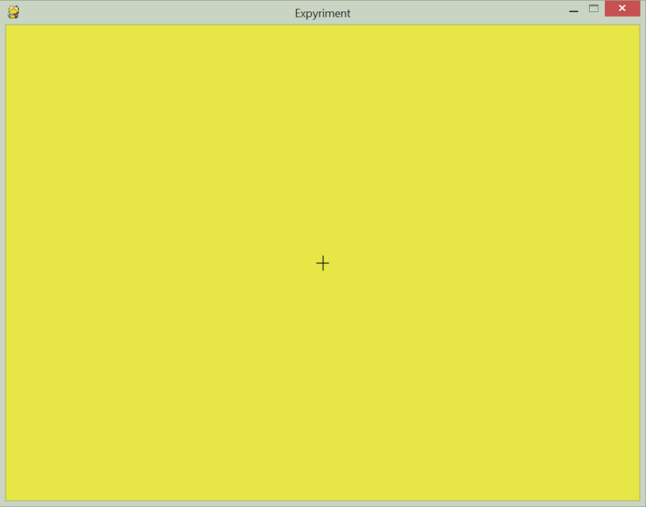
2. Expyriment - Stimuli
So right now, our program looks like this
Theoretically. We wouldn’t see it because it, again, immediately closes after opening
But we will fix this in a second
For now, believe us it’s there
from expyriment import design, control, stimuli
control.defaults.window_mode = True
control.defaults.window_size = [800,600]
design.defaults.experiment_background_colour = (230,230,70)
exp = design.Experiment(name="Cool Experiment")
control.initialize(exp)
block_one = design.Block(name="Our only block")
tmp_trial = design.Trial()
cross = stimuli.FixCross(colour=(0,0,0))
cross.preload()
tmp_trial.add_stimulus(cross)
block_one.add_trial(tmp_trial)
exp.add_block(block_one)
control.start()
for b in exp.blocks:
for t in b.trials:
t.stimuli[0].present() exp.keyboard.wait()
control.end()

Slide 37
2. Expyriment - Stimuli
We decide to add another stimulus that will be moving around again
As there is is no template for a grating stimulus in Expyriment, a circle will have to do
For both stimuli to be displayed, we will have to change up the presenting part a bit
As of now, not only will only the first of two stimuli in the trial be displayed, but also the buffer will be flipped directly after
Which means that the next object would be drawn on the other buffer
But we want both stimuli to be drawn on the same buffer
stim = stimuli.Circle(radius=25, colour=(0,0,0),position=[-100,0])
tmp_trial.add_stimulus(stim)
for b in exp.blocks:
for t in b.trials:
t.stimuli[0].present()

Slide 38
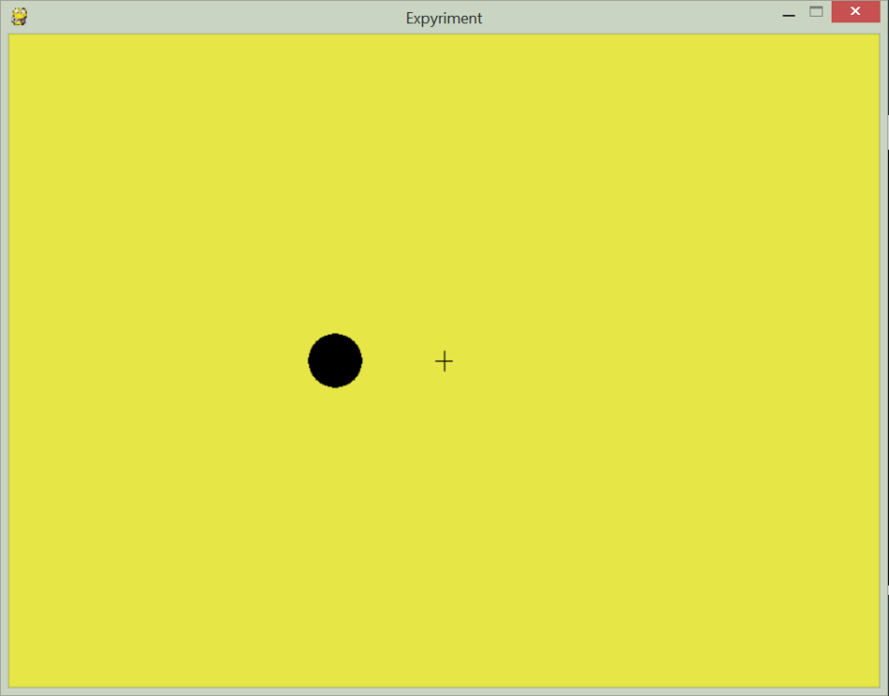
2. Expyriment - Stimuli
Therefore, we add a line that presents the second stimulus and also change up the present() functions to
Clear the screen, then present the first stimulus, but do NOT flip the buffers
Do NOT clear the screen (we’ve just drawn the first stimulus on it), but draw the second stimulus, then flip the buffers
And voilà!
t.stimuli[0].present(clear=True, update=False)
t.stimuli[1].present(clear=False, update=True)

Slide 39
3. Expyriment - User Input - keyboard.wait()
Let’s take care of our window closing problem
This is easy as the Expyriment equivalent for waitKey() works really similarly
It is named keyboard.wait() and can be called on the experiment object
Again, we can specify things like which keys to look for
Even fancier, this function will return the time it took the user to press the key in milliseconds!
for b in exp.blocks:
for t in b.trials:
t.stimuli[0].present(clear=True, update=False)
t.stimuli[1].present(clear=False, update=True)
exp.keyboard.wait()

Slide 40
3. Expyriment - User Input: Global Keys
Again, we want to define a key with which we can quit the program
There is actually an extra method called set_quit_key() for this
27 is the ASCII equivalent for the escape button, so we hand it over as a parameter
exp.keyboard.set_quit_key(27)

Slide 41
3. Expyriment – Code Overview
So you have a reference of what the code looks like so far:
from expyriment import design, control, stimuli
control.defaults.window_mode = True
control.defaults.window_size = [800,600]
design.defaults.experiment_background_colour = (230,230,70)
exp = design.Experiment(name="Cool Experiment")
control.initialize(exp)
exp.keyboard.set_quit_key(27)
block_one = design.Block(name="Our only block")
tmp_trial = design.Trial()
cross = stimuli.FixCross(colour=(0,0,0))
cross.preload()
stim = stimuli.Circle(radius=25, colour=(0,0,0),position=[-100,0])
stim.preload()
tmp_trial.add_stimulus(cross)
tmp_trial.add_stimulus(stim)
block_one.add_trial(tmp_trial)
exp.add_block(block_one)
control.start()
for b in exp.blocks:
for t in b.trials:
t.stimuli[0].present(clear=True, update=False)
t.stimuli[1].present(clear=False, update=True)
exp.keyboard.wait()
control.end()

Slide 42
4. Expyriment – Experiment Procedures
There are no handlers in Expyriment, so we will have to come up with the experiment procedures ourselves
The only thing left to do is make our stimulus move around
So we change up the code just a bit to allow for more trials
Note that we create a new Circle object each trial and make a deep copy of tmp_trial() before clearing it - we need to do this as Expyriment will only hand over references when adding stimuli to trials or trials to blocks
So if we didn’t reinitialize the stimuli or trials, changing one of them would change all of them
cross = stimuli.FixCross()
cross.preload()
# define stimulus positions
positions = [-400, -200, 0, 200, 400]
# go through all positions
for xpos in positions:
# create circle accordingly
stim = stimuli.Circle(radius=25, colour=(0,0,0),position=[xpos,0])
stim.preload()
# add both stimuli to the trial
tmp_trial.add_stimulus(stim)
tmp_trial.add_stimulus(cross)
# add the trial to the block
block_one.add_trial(tmp_trial)
# make a deep copy of the trial and clear it for the next iteration
tmp_trial = tmp_trial.copy()
tmp_trial.clear_stimuli()
cross = stimuli.FixCross(colour=(0,0,0))
cross.preload()
stim = stimuli.Circle(radius=25, colour=(0,0,0),position=[-100,0])
stim.preload()
tmp_trial.add_stimulus(cross)
tmp_trial.add_stimulus(stim)
block_one.add_trial(tmp_trial)
exp.add_block(block_one)

Slide 43
4. Expyriment – Complete Code
from expyriment import design, control, stimuli
control.defaults.window_mode = True
control.defaults.window_size = [800,600]
design.defaults.experiment_background_colour = (230,230,70)
exp = design.Experiment(name="Cool Experiment")
control.initialize(exp)
exp.keyboard.set_quit_key(27)
block_one = design.Block(name="Our only block")
tmp_trial = design.Trial()
cross = stimuli.FixCross(colour=(0,0,0))
cross.preload()
cross = stimuli.FixCross()
cross.preload()
positions = [-400, -200, 0, 200, 400]
for xpos in positions:
stim = stimuli.Circle(radius=25, colour=(0,0,0),position=[xpos,0])
stim.preload()
tmp_trial.add_stimulus(stim)
tmp_trial.add_stimulus(cross)
block_one.add_trial(tmp_trial)
tmp_trial = tmp_trial.copy()
tmp_trial.clear_stimuli()
exp.add_block(block_one)
control.start()
for b in exp.blocks:
for t in b.trials:
t.stimuli[0].present(clear=True, update=False)
t.stimuli[1].present(clear=False, update=True)
exp.keyboard.wait()
control.end()

Slide 44
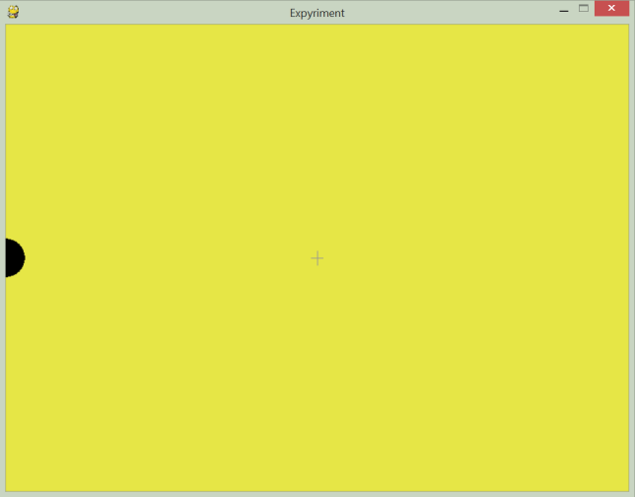
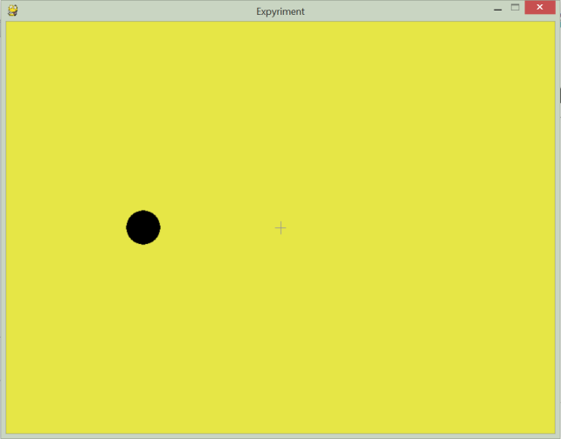
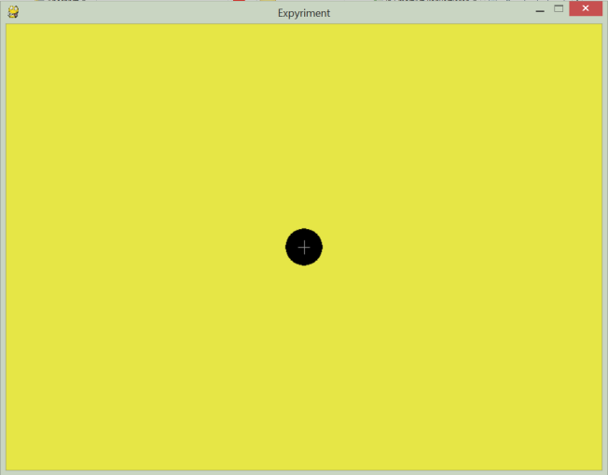
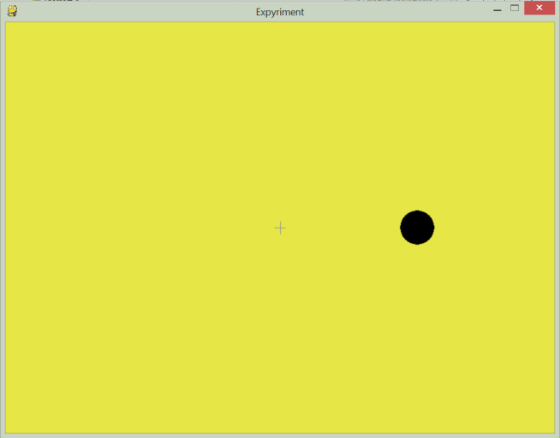
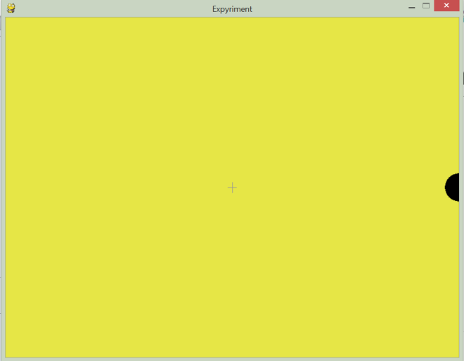
4. Expyriment - The Program

Slide 45
5. Expyriment - Data Logging
Like with PsychoPy, we will leave it to you if you want to use the usual Python file handling methods or the ones specific to Expyriment
You can, of course, find more information in the documentation
Especially http://docs.expyriment.org/expyriment.io.html provides multiple classes working with files

Slide 46
Expyriment – Code Structure
from expyriment import design, control, stimuli
control.defaults.window_mode = True
control.defaults.window_size = [800,600]
design.defaults.experiment_background_colour = (230,230,70)
exp = design.Experiment(name="Cool Experiment")
control.initialize(exp)
exp.keyboard.set_quit_key(27)
block_one = design.Block(name="Our only block")
tmp_trial = design.Trial()
cross = stimuli.FixCross(colour=(0,0,0))
cross.preload()
cross = stimuli.FixCross()
cross.preload()
positions = [-400, -200, 0, 200, 400]
for xpos in positions:
stim = stimuli.Circle(radius=25, colour=(0,0,0),position=[xpos,0])
stim.preload()
tmp_trial.add_stimulus(stim)
tmp_trial.add_stimulus(cross)
block_one.add_trial(tmp_trial)
tmp_trial = tmp_trial.copy()
tmp_trial.clear_stimuli()
exp.add_block(block_one)
control.start()
for b in exp.blocks:
for t in b.trials:
t.stimuli[0].present(clear=True, update=False)
t.stimuli[1].present(clear=False, update=True)
exp.keyboard.wait()
control.end()
First, change defaults
(if needed)
Then, create and initialize
experiment
Here, we have
room for
experiment-specific
configurations
Then, define Block and
Trial objects
Then, start the experiment
Then, construct your
blocks, trials and stimuli
Then, define your procedures
Finally, end the experiment

Slide 47
Structured Data

Slide 48
Data So Far
So far we have mostly considered simple text data
Just a collection of strings that were saved in the same file
In the hangman example we structured data, by having one word per line
But this is often not enough to display more complex data structures
E.g. the data of several trials of one subject, or image data with labels, etc.
One option would be to store each entry in a single file
But this is hard to keep track off, slow to process and a mess to organise
This is why there are several structured data types
In the following we will have a look at some of those
Even though it will still be just strings, they are in certain order now

Slide 49
Why Structure Data?
It provides a director way of handling data structures as present in programming, often at the cost of human readability
It makes reading and writing data streamlined
This makes data transferable and (re)?usable (with 3rd party tools|)
Standards make collaboration and handling easier
There are many standards with different advantages and disadvantages
We will look at two of the (arguably) more prominent ones: CSV and JSON

Slide 50
CSV – What It Is
CSV stands for Comma Separated Values
It is a plain text representation of tabular data
Since a table is a graphical object, we need some way of putting it into a text representation
The first row contains the names of the fields
Each row represents one record in the table
All records must have the same number of fields
The values of the fields are separated by a comma
data_log.csv
timestamp, level, err_id, message
20180619T160252, ERROR, 404, Site not found
20180619T160334, WARNING, 37, div overflow
20180619T162732, ERROR, 408, timeout
timestamp | level | err_id | message
20180619T160252 | ERROR | 404 | Site not found
20180619T160334 | WARNING | 37 | div overflow
20180619T162732 | ERROR | 408 | timeout

Slide 51
CSV – What It Is
If a comma is in a field value, that value is often enclosed in quotation marks like a string
If we then need to use quotation marks in the value, we need to escape those
You can get around this by using different quotation marks
data_log.csv
timestamp, level, err_id, message
20180619T160252, ERROR, 404, "Site not found, http://localhost:8088/db"
20180619T160334, WARNING, 37, div overflow
20180619T162732, ERROR, 408, "timeout, 10 \"sec\""
timestamp | level | err_id | message
20180619T160252 | ERROR | 404 | Site not found, http://localhost:8088/db
20180619T160334 | WARNING | 37 | div overflow
20180619T162732 | ERROR | 408 | Timeout, 10 “sec”

Slide 52
CSV - Advantages
It is a very lightweight format
The file size of a csv file is often smaller than the same data in a comparable format
It is easily streamable / separable
Since the content can be examined row by row, there is no need to load the whole file to process it
This makes it useful if you are limited on working memory or need to transmit it via a network
It is straightforward to process and still fairly readable
Is used commonly in (data) science or financing, thus there exists an abundance of software for it
It follows a certain schema, so that each record is similar

Slide 53
CSV - Disadvantages
There are many files, that call themselves csv, but are not obliging to the rules
Some use tabs, spaces or semicolons as separators instead of commas
Some use different quotes or escape characters
That makes dealing with csv files unreliable, at times as files have to be checked manually first so that parameters can be set accordingly
While many things can be displayed in a tabular format, it is not optimal for all data
Especially hierarchical or dictionary structures are not well represented
experiment_data.csv subject_id, stim_id, stim_onset, subj_react
0, 0, 5123.21, 5127.19
0, 1, 5352.91, 5362.01
1, 0, 3213.22, 3214.10
1, 1, 4244.76, 4246.82
trees.csv
id, parent_id, children_ids, content
0, na, "[1,2,3]", "I. Am. Root."
1, 0, "[4]", "content_id: 2"
2, 0, "[]", "content_id: 23"
3, 0, "[]", na
4, 1, "[]", "content_id: 32"

Slide 54
JSON – What It Is
JSON stands for JavaScript Object Notation
It is a plain text representation of objects or object data
It is very similar to the Python dictionary
A JSON file always consists of a single JavaScript object
This means it starts with a curly brace and ends with one. {} is a valid object
This object consists of unordered key : value pairs, with a colon between key and value
The key is a unique string in double-quotes
The value can be one of many things
The key-value pairs are separated by commas
{
"colors": [
{
"color": "black",
"category": "hue",
"type": "primary",
"code": {
"rgba": [255,255,255,1],
"hex": "#000"
}
},
{
"color": "white",
"category": "value",
"code": {
"rgba": [0,0,0,1],
"hex": "#FFF"
}
}
]
}

Slide 55
JSON – What It Is
The value can be
A string (in double-quotes)
A number
int or float works, as well as scientific notation
Another JavaScript object
An array
Values separated by commas in square brackets akin to a Python list
The Boolean values true and false
Not capitalised unlike Python
They do not need quotation marks
null
The same as None in Python
{
"colors": [
{
"color": "black",
"category": "hue",
"type": "primary",
"code": {
"rgba": [255,255,255,1],
"hex": "#000"
}
},
{
"color": "white",
"category": "value",
"code": {
"rgba": [0,0,0,1],
"hex": "#FFF"
}
}
]
}

Slide 56
JSON – Advantages
It is also a fairly lightweight format
Not as lightweight as csv, but more powerful
It can represent hierarchical data structures (to a certain extent), as well as different data types
It has code counterparts (Python dict, JS object, C/C++/Java HashMap, …), and thus straightforward to process and still readable
It is schema free, meaning you can expand it more dynamically
It is used commonly throughout the web, (data) science and especially computer science
There exist databases built around/with JSON, so called document based db

Slide 57
JSON – Disadvantages
Can get convoluted quickly and thus hard to read by a human
Always has to be loaded in full to be parsed
Still not expressive enough for complex data structures
It is schema free, meaning that each record inside can vary
This can make processing between systems difficult or lead to wrong processing
Or at the very least makes verifying harder

Slide 58

Image Data – A Short Word
Digital images are just a series of numbers
They are a grid structure, where each cell is one pixel of the image
A ndarray from numpy for example
Each pixel then has its colour information
As seen in the JSON example colour can be represented in different values
The ones to know are probably RGBA and hexcodes
Therefore an image is a 3d array
The first two dimensions are the pixel grid
The third dimension is the colour information
Hence, we can perform all kinds of mathematical operations on images, like we would on any array
A cute yawning cat taken from pixnio.com

Slide 59
Honourable Mentions
XML | One of the most used formats with static types, namespaces and hierarchy.
Database formats (SQL, Documents, Graphs, etc.) | The most complex, but also the most powerful of the bunch. They allow complex data structures and operations with good speed.
HTML | HyperText Markup Language. One of the backbones of the www
Office Document Formats (docx, odt, xlsx, pptx, rtf, etc.) | Often a form of xml, they can be used to store all kinds of data, like formatted text, tabular data, …
PDF | Made to be portable, but a pain to work with
Audio (mp3, wav, etc.) | Digital audio, just like pictures, is a bunch of numbers. Fairly nice to work with.
Video (mpeg4, ogg, etc.) | Videos are like images, but many of them. Still nice to work with.
MAT | Matlab formatted data. A binary proprietary format that can contain pretty much anything. Not humanly readable.
BLOB | Binary Large OBjects are binarized data files. Often they are compressed versions of the file formats above.

Slide 60
Working on Data: Pandas

Slide 61
Pandas
“pandas is an open source, BSD-licensed library providing high-performance, easy-to-use data structures and data analysis tools for the Python programming language.”
pandas.pydata.org
Pandas is a library built on top of numpy to further increase the capability of working with data
It provides functionality to work with labelled data, time series and is robust against heterogeneity and missing data
Pandas implements the data structures that are also present in R, which is great for inspecting, cleaning and analysing data
If you did not already you can install Pandas with conda or pip
In Python you can use pandas as import pandas as pd
Code in the following will presume imports of pandas as pd, numpy as np, and pyplot as plt

Slide 62
Pandas Datatypes: Series
A Pandas Series^{[1]} is a one-dimensional array of indexed data
At first, this might sound like a simple numpy ndarray, but the key difference is that indexed part
We can create a series from any object that can be a ndarray, and we can optionally provide an index list of same length
We can then index the series not just by numbers, like we are used to, but using the index values as well
data = pd.Series([0.5, 1, 2, 2.5])
print(data, data[1], data[1:3], "", sep="\n")
index = ['a', 'b', 'c', 'z']
data.index = index
print(data, data['a'], sep="\n")
Output:
0 0.5
1 1.0
2 2.0
3 2.5
dtype: float64
1.0
1 1.0
2 2.0
dtype: float64
a 0.5
b 1.0
c 2.0
z 2.5
dtype: float64
0.5
class pandas.Series(data=None, index=None, dtype=None, name=None, copy=False, fastpath=False)
[1]https://pandas.pydata.org/pandas-docs/stable/generated/pandas.Series.html

Slide 63
Pandas Datatypes: Series
So instead of thinking of Series as an array, we might think of it more akin to a dictionary
It is a generalisation of an array, and a specialisation of a dict
With the index being any kind of value and referring to one value, it is reminiscent
But differently to a dict, order is preserved
We can slice the series even using index values
population_dict = {'Germany': 80716000, 'France': 67210000, 'UK': 64100000, 'Sweden': 10004962}
population = pd.Series(population_dict)
print(population, population['Germany'], population['France':'UK'], sep="\n")
Output:
Germany 80716000
France 67210000
UK 64100000
Sweden 10004962
dtype: int64
80716000
France 67210000
UK 64100000
dtype: int64

Slide 64
Pandas Datatypes: Dataframes
A dataframe^{[1]} (df) is a collection of series, creating a tabular data structure
Each column is one series and each row is one record with one value for each column
A df also has an index, and all series / columns of the df share this same index
Like series were generalisations of 1d arrays, dfs are generalisations of 2d arrays
And like series were specialised dictionaries, dfs are specialised dictionaries with a column name as a key and a series as a value
area_dict = {'Germany': 357168, 'France': 643801, 'UK': 243610, 'Sweden': 449964}
area = pd.Series(area_dict)
df = pd.DataFrame({'population': population, 'area': area})
print(df, df['area'], df.loc['France'], sep="\n\n")
Output:
population area
Germany 80716000 357168
France 67210000 643801
UK 64100000 243610
Sweden 10004962 449964
Germany 357168
France 643801
UK 243610
Sweden 449964
Name: area, dtype: int64
population 67210000
area 643801
Name: France, dtype: int64
class pandas.DataFrame(data=None, index=None, columns=None, dtype=None, copy=False)
[1] https://pandas.pydata.org/pandas-docs/stable/generated/pandas.DataFrame.html

Slide 65
Pandas Datatypes: Dataframes
Accessing a column returns a Series object
You can also use a list of dictionaries to create a dataframe, where each dict is one record
Remember how we used dicts to represent object data like albums? Now we can make those into one database
The dataframe will always use all present keys, even if the keys are not present in all supplied column data
Any 2d numpy array can be made into a dataframe
df = pd.DataFrame({'population': population,
'area': area})
print(type(df['population']))
peter = {'name': 'Peter', 'fav_colour': 'blue'}
susan = {'name': 'Susan', 'fav_colour': 'green', 'pet': 'Oscar'}
df = pd.DataFrame([peter, susan])
print(df)
df = pd.DataFrame(np.random.rand(3, 2),
columns=['foo', 'bar'], index=['a', 42, True])
print(df, df.columns, df.values, df.index, sep="\n")
Output:
<class 'pandas.core.series.Series'>
fav_colour name pet
0 blue Peter NaN
1 green Susan Oscar
foo bar
a 0.335329 0.181496
42 0.632545 0.201658
True 0.113261 0.744242
Index(['foo', 'bar'], dtype='object')
[[0.33532876 0.18149577]
[0.63254465 0.20165753]
[0.1132611 0.74424223]]
Index(['a', 42, True], dtype='object')

Slide 66
Pandas Datatypes: Index
Series and DataFrame both have an index
This index^{[1]} is another pandas object, which is a one-dimensional array
They share many attributes with numpy’s ndarrays like size, shape, ndim and dtype
But index objects are immutable and they are ordered sets
You cannot assign single values of an index
All entries are unique
The order of the entries is preserved
It is a good idea to only have indices of the same type
idx = pd.Index(['a', 'b', 'c']) # stick to one
print(idx[1], idx[0:1:-1], idx.shape, idx.dtype)
idx = pd.Index([1, 2, 'dog']) # don't mix ints and strings
idx[2] = 3 # oh no index is immutable
Output:
b Index([], dtype='object') (3,) object
Traceback (most recent call last):
File "e:/Libraries/OneDrive/Uni_encrypted/Orga/Course/SS2018/BPP/2018/12/code.py", line 29, in <module>
idx[2] = 3 # oh no index is immutable
File "C:\Users\nipsh\Anaconda3\lib\site-packages\pandas\core\indexes\base.py", line 2051, in __setitem__
raise TypeError("Index does not support mutable operations")
TypeError: Index does not support mutable operations
class pandas.Index(data=None, dtype=object, copy=False, name=None, tupleize_cols=True)
[1]https://pandas.pydata.org/pandas-docs/stable/generated/pandas.Index.html

Slide 67
Loading Data
Pandas implements functionality to load from a lot of different data sources
From pickle, csv, your clipboard, excel, json, html, sql, Google BigQuery, and some more
You can easily handle these formats using pd.read_<file_format>(filepath_or_buffer)
df = pd.read_csv(“my_csv_file.csv”)
df = pd.read_json(open(“my_file.json”))
Pandas automatically uses the header row as column names, and then creates a dataframe

Slide 68
Working With Data
We have our data loaded and are all setup, so now we can start working
The procedure would be
Collect the data
Either by an experiment, or from other sources, depending on what you are doing
Extracting & inspecting the data
see if there were loading issues or if the dataframe looks good, and if the data looks homogeneous
Visualising the data
Plotting the data can really help to spot regularities and get a general idea about your data (e.g. whether there is a correlation, how the data is spread, etc.)
Analysing the data
Fitting a statistical model, checking variances, means, and other measures as well, to understand the metric of your data and maybe draw conclusions, as well as…
Update the data collection
Change the experiment setup to control for more variables, exclude certain data sets when scraping, etc…. And repeat.

Slide 69
Inspecting Data
We have now extraced our data from files or other objects and are ready to look at it
To peek into a dataframe or series we can use data.head(n=5)
It returns the first n rows, so you can make sure the format is correct
We can use the same attributes as in numpy to check the shape of the data
size, shape, the transpose, etc.
df = pd.DataFrame({'population': population,
'area': area})
print(df.head())
print(df.size, df.shape, df.T)
Output:
population area
Germany 80716000 357168
France 67210000 643801
UK 64100000 243610
Sweden 10004962 449964
8 (4, 2) Germany France UK Sweden
population 80716000 67210000 64100000 10004962
area 357168 643801 243610 449964

Slide 70
Inspecting Data
A handy method on dataframes is info()
It displays a summary of column names, data types and missing data
There exists another powerful function: describe()
It outputs even some statistical meausrements
print(df.info(), "\n")
print(df.area.describe())
Output:
<class 'pandas.core.frame.DataFrame'>
Index: 4 entries, Germany to Sweden
Data columns (total 2 columns):
population 4 non-null int64
area 4 non-null int64
dtypes: int64(2)
memory usage: 256.0+ bytes
None
count 4.000000
mean 423635.750000
std 169305.588123
min 243610.000000
25% 328778.500000
50% 403566.000000
75% 498423.250000
max 643801.000000
Name: area, dtype: float64
DataFrame.info(verbose=None, buf=None, max_cols=None,
memory_usage=None, null_counts=None)
Series.describe(percentiles=None,
include=None, exclude=None)

Slide 71
Locating Data
When the data looks good, we might want to extract certain apsects or data fields
We already know how to index lists and arrays
We will now look at how flexible Pandas is when indexing a Series or a DataFrame
And what to look out for
a = np.arange(16).reshape(4, 4)
print(a)
# Takes those values of the second and
# fourth column that are divisible by 3
print(a[:, [1, 3]][a[:, [1, 3]] % 3 == 0])
Output:
[[ 0 1 2 3]
[ 4 5 6 7]
[ 8 9 10 11]
[12 13 14 15]]
[ 3 9 15]

Slide 72
Locating Data: Series
As said before, a Series object behaves much like an overlap between a numpy ndarray and a Python dictionary
Like a dictionary a Series provides a mapping from key to value
We can access any item in the Series by indexing it as we would with a dict
In fact we can even call the dict method keys() on it
data = pd.Series([0.25, 0.5, 0.75, 1.0],
index=['a', 'b', 'c', 'd'])
print(data)
print('b' in data)
print(data.keys() == data.index)
print(list(data.items()))
data['e'] = 1.25
print(data)
Output:
a 0.25
b 0.50
c 0.75
d 1.00
dtype: float64
True
[ True True True True]
[('a', 0.25), ('b', 0.5), ('c', 0.75), ('d', 1.0)]
a 0.25
b 0.50
c 0.75
d 1.00
e 1.25
dtype: float64

Slide 73
Locating Data: Series
But since Series also are like arrays, we can index and slice them as such
For this we can use the explicit index
So the values inside the Series.index
Or the implicit integer index
How we would index a “normal” array
Remember, that when indexing lists and arrays the end of the slice is exclusive
For Series this only applies if using the implicit integer index, but when we use the explicit index the end is inclusive
We can also use a list of indices to extract several specific values
If the index of a Series already is an integer list, the slice will use implicit indexing, but a direct access will use explicit indexing
data = pd.Series([0.25, 0.5, 0.75, 1.0],
index=['a', 'b', 'c', 'd’])
print(data['a':'c']) # explicit: inclusive slice
print(data[0:2]) # implicit: exclusive slice
print(data[['a','e']) # fancy!
data.index = [1, 2, 3, 4, 5]
print(data[1])
print(data[0:2])
Output:
a 0.25
b 0.50
c 0.75
dtype: float64
a 0.25
b 0.50
dtype: float64
a 0.25
e 1.25
dtype: float64
0.25
1 0.25
2 0.50
dtype: float64

Slide 74
Locating Data: loc & iloc
Since that behaviour is somewhat counterintuitive, there is a workaround
Every Series has the attributes loc and iloc
iloc makes it possible to always use the implicit integer index just like we are used to
loc makes it possible to always use the explicit index which means inclusive slices and fancy indexing
Always use loc and iloc!
Making explicit what you want to do, is always the preferred (and readable) way
print(data, "\n")
print(data.loc[1],
data.loc[1:3], "\n",
data.iloc[1],
data.iloc[1:3])
Output:
1 0.25
2 0.50
3 0.75
4 1.00
5 1.25
dtype: float64
0.25 1 0.25
2 0.50
3 0.75
dtype: float64
0.5 2 0.50
3 0.75
dtype: float64

Slide 75
Locating Data: DataFrame
Most of what we said about Series applies to DataFrames as well
Since we now have two dimensions, indexing is ambiguous
Accessing a DataFrame by index refers to the columns
Slicing a DataFrame refers to the rows
DataFrames also supply the loc and iloc attributes
population_dict = {'Germany': 80716000, 'France': 67210000, 'UK': 64100000, 'Sweden': 10004962}
population = pd.Series(population_dict)
area_dict = {'Germany': 357168, 'France': 643801,
'UK': 243610, 'Sweden': 449964}
area = pd.Series(area_dict)
df = pd.DataFrame({'population': population,
'area': area})
print(df['area’])
print(df['Germany':'UK'])
Output:
Germany 357168
France 643801
UK 243610
Sweden 449964
Name: area, dtype: int64
population area
Germany 80716000 357168
France 67210000 643801
UK 64100000 243610

Slide 76
Locating Data: loc & iloc
When dealing with DataFrames, loc and iloc take two indices instead of one
The first indexes the rows and the second indexes the columns of the DataFrame
Again iloc is the implicit integer indexing and the end of slicing is exclusive
And loc is the explicit indexing and the end of slicing is inclusive
This way we can also access single rows
And again: Always use loc and iloc!
print(df.iloc[1:3, :2])
print(df.loc['France':'Sweden', :'area'], "\n")
print(df.loc['UK', :])
Output:
population area
France 67210000 643801
UK 64100000 243610
population area
France 67210000 643801
UK 64100000 243610
Sweden 10004962 449964
population 64100000
area 243610
Name: UK, dtype: int64

Slide 77
Boolean Indexing
You can create a mask to only select cells that fit a certain criteria
This way you can easily and controlled update or delete values
This is also useful to extract a subset of your Data
print(df['area'] > 400000)
print(df[df['area'] > 400000])
Output:
Germany False
France True
UK False
Sweden True
Name: area, dtype: bool
population area
France 67210000 643801
Sweden 10004962 449964
Notes:
LIVE CODING WITH POKEMON.CSV FOR THE FUN STUFF!

Slide 78
Resources
If you want to read up more on Data Science in Python I strongly recommend having a look at “Python Data Science Handbook”
It is a great collection of resources to understand and work with data
It covers some topics we talked about like NumPy, Matplotlib and Pandas, but in greater detail
And they provide it for free! In Jupyter Notebooks on GitHub
github.com/jakevdp/PythonDataScienceHandbook/tree/master/notebooks
Have a look around, and read upon some stuff if you are interested

Slide 79
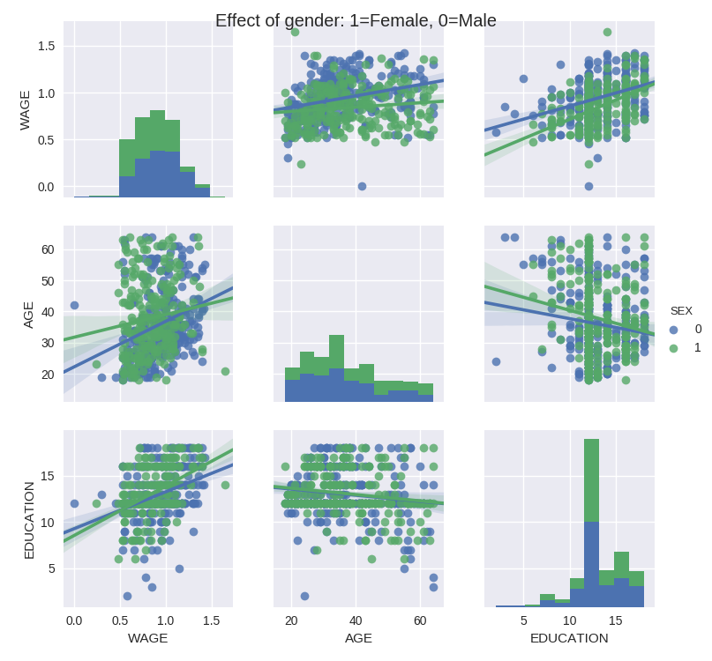
Statistics
Together with the statsmodels library, Pandas gets near full R functionality
Including
Model fitting
Linear and multiple regression
Statistical analysis
Plotting and visual analysis
And much more
There is nice scipy tutorial blog on this: www.scipy-lectures.org/packages/statistics/index.html#linear-models-multiple-factors-and-analysis-of-variance
It is a bit fast paced but still a good reference and/or starting point

Slide 80
Homework

Slide 81
Experiment!
This week you will be tasked with creating a small experiment
Collecting some data
And plotting / visualising this data
No worries, there will be more guidelines than usual

Slide 82
See you all next week!

